Slide 1

The role of economic modelling – a brief introduction
Francis Ruiz
NICE International
© NICE 2014

Slide 2
“Vampire of trials or Frankenstein’s monster”
Study-based
Randomised controlled trials
Quasi-experimental studies
Observational studies
Model-based
Meta-analysis
Decision trees
Markov models
Micro-simulation
Modelling - ‘An unavoidable fact of life’:
to extrapolate beyond limited trial follow-up
to link intermediate endpoints to final outcomes
to generalise to other settings
to synthesise comparisons
Notes:
Bernie O’Brien has summarised the difference between trial-based and modelling approaches to economic evaluation:
a “vampire of trials” approach - where EE is parasitic on a clinical trial;
and the “Frankenstein’s monster” modelling approach, where we bolt together data from various sources.
However, this is really a false distinction, because EEs almost always involve some level of modelling:
e.g. for unit cost data;
or extrapolation of trial data beyond limited follow-up.
Vampires do not exist!
Modelling is inevitable. Implicit vs explicit model

Slide 3
So what is a ‘model’?
Test accuracy Sensitivity/specificity
Treatment effects Survival, health status
Resource use GP visits, IP stays…
Preferences QoL weights
Unit costs e.g £ per GP visit
Epidemiology Baseline risks, sub-groups
MODEL
Cost Effectiveness £/QALY
Notes:
So, for example, we may get data:
on clinical effectiveness from a trial or meta-analysis of trials;
data on test accuracy from a cohort study;
data on resource use by reviewing a sample of patients notes;
estimates of unit costs from accounting data;
estimates of quality of life (health state valuations) by a special study of a sample of patients;
and extrapolate findings forward using epidemiological data on survival.
We then use a mathematical or computer model to bring together the data and estimate our summary statistic (the ICER).
Ideally data inputs will be based on best available evidence from guideline reviews.
But in many cases data is not available – so GDG may be asked to use judgement to make assumptions.

Slide 4
The modelling process
2. Select inputs Use best available evidence to inform choice of data inputs
1. Design model Base on clinical judgement of key aspects of disease and treatment process
4. Review Go back and collect more information or check assumptions if necessary
3. Analysis Calculate results & test robustness to changes in assumptions and data
Notes:
So, for example, we may get data:
on clinical effectiveness from a trial or meta-analysis of trials;
data on test accuracy from a cohort study;
data on resource use by reviewing a sample of patients notes;
estimates of unit costs from accounting data;
estimates of quality of life (health state valuations) by a special study of a sample of patients;
and extrapolate findings forward using epidemiological data on survival.
We then use a mathematical or computer model to bring together the data and estimate our summary statistic (the ICER).
Ideally data inputs will be based on best available evidence from guideline reviews.
But in many cases data is not available – so GDG may be asked to use judgement to make assumptions.

Slide 5
DECISION TREES
A simple way of estimating expected costs and effects of alternative actions

Slide 6
Draw the tree
Well
Choice node
A
Sick
Chance nodes
Outcomes
B
Well
Sick

Slide 7
Add data
Probabilities
QALYs
Cost
30%
0.8
£4,000
A
70%
0.2
£8,000
B
50%
0.8
£6,000
50%
0.2
£10,000
Health outcomes & costs for endpoints
Notes:
ICEr is calculated by rolling hte tree and calculatingexpected mean cost for each option

Slide 8
Calculate results
Calculate mean costs and QALYs for each option (A & B)
QALYs
Cost
30%
0.8
£4,000
A
70%
0.2
£8,000
B
50%
0.8
£6,000
30% x £4000
+
70% x £8000
50%
0.2
£10,000
 | A | B | Difference
Expected cost | £6,800 | £8,000 | £1,200
Expected QALYs | 0.38 | 0.50 | 0.12
ICER (£ per QALY) = |  |  | £10,000
Notes:
B, DIFFERENCE AND ICERS ARE HIDDEN
EXERCISE

Slide 9
Modelling chronic & recurrent diseases
Decision trees become ‘twiggy’ & unmanageable
Can simplify with a Markov model…
3rd time…
2nd time
1st time

Slide 10
Markov models
A method for estimating long term costs and effects for recurrent or chronic conditions

Slide 11
Markov models: Design the model
Choose ‘cycle’ length (day, week, month, year…)
Define possible ‘health states’
Well
Sick
State 1
State 2
Dead
State 3
Identify feasible transitions
Notes:
In state transition models:
We allocate members of a population to one of a finite number of ‘states’ (e.g. ‘well’, ‘sick’ and ‘dead’).
We then specify the probabilities of moving between the states in consecutive time periods.
NB Death is a ‘sink’ state - there is no way out of it!

Slide 12
Markov models: Add data
Attach costs & QoL to each health state
75% pa
£100 pa QoL=1
£1,000 pa QoL=0.6
Well
5% pa
Sick
94% pa
20% pa
1% pa
£0 pa QoL=0
Dead
5% pa
100% pa
Define probability of transitions per cycle
pa= per annum
Notes:
In state transition models:
We allocate members of a population to one of a finite number of ‘states’ (e.g. ‘well’, ‘sick’ and ‘dead’).
We then specify the probabilities of moving between the states in consecutive time periods.
NB Death is a ‘sink’ state - there is no way out of it!

Slide 13
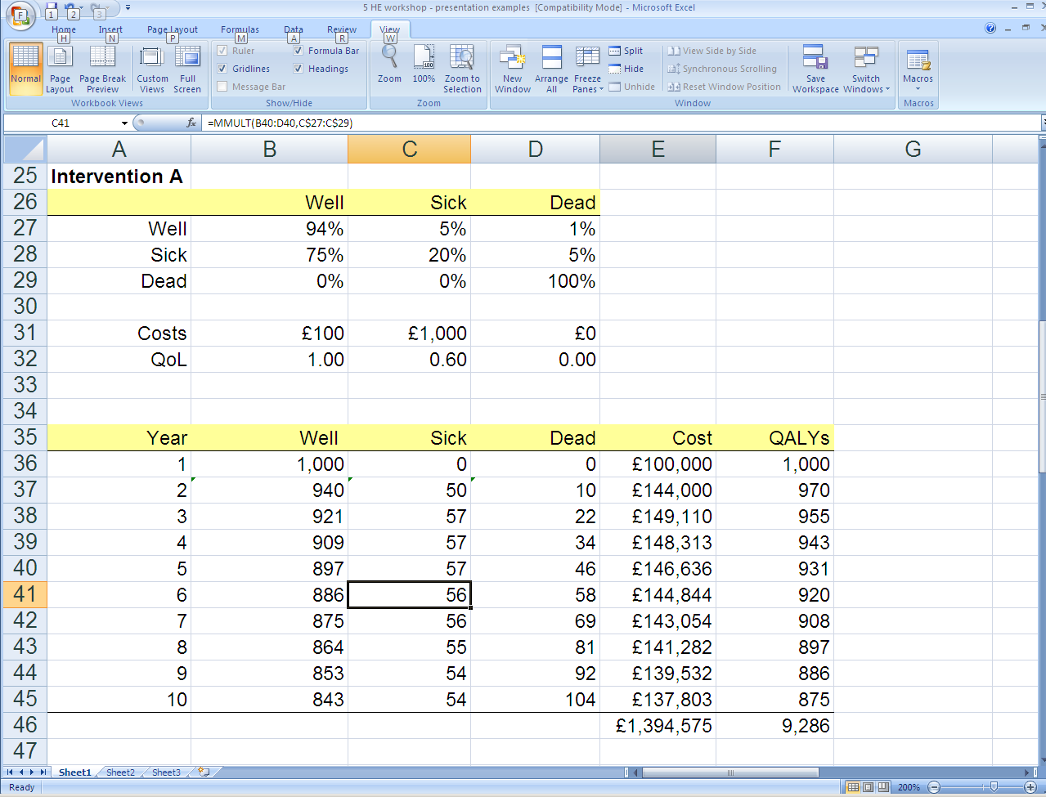
A simple Markov model… in excel

Slide 14
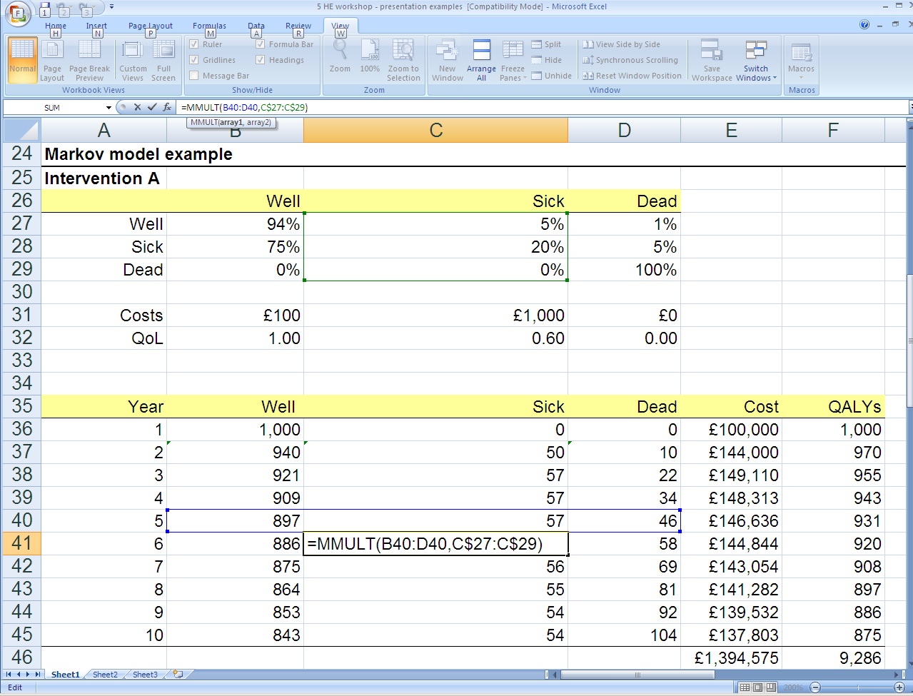
A simple Markov model… in excel
Notes:
The fixed probability here is flawed.

Slide 15
Markov models: Repeat for each intervention & calculate ICER
Intervention A
Intervention B
75%
78%
£100 pa QoL=1
5%
£1,000 pa QoL=0.6
£200 pa QoL=1
4%
£1,100 pa QoL=0.6
1%
1%
£0 pa QoL=0
5%
£0 pa QoL=0
5%
 | A | B | Difference
Expected cost | £1,394,575 | £2,250,404 | £855,830
Expected QALYs | 9,286 | 9,345 | 59
ICER (£ per QALY) = |  |  | £14,466
Notes:
In state transition models:
We allocate members of a population to one of a finite number of ‘states’ (e.g. ‘well’, ‘sick’ and ‘dead’).
We then specify the probabilities of moving between the states in consecutive time periods.
NB Death is a ‘sink’ state - there is no way out of it!
For smoking it doesnt take it into account the times u took to try to quit.
Micorsimulaiton has issues wth replication, its intensive because its individual patient data, based on long term cohort data ( diabetes data in UK)

Slide 16
Some issues…
Don’t forget to discount…
Half-cycle correction in a discrete time Markov model
Adjust so that transitions occur at mid-point in a cycle
May not matter where the focus is on the incremental costs and outcomes
Markov assumption
“Memoryless” – once transition is made, population in a particular health state is considered homogeneous regardless of where they’ve come from (and when)…

Slide 17
Building time-dependency into a Markov model
Different types
Probabilities can vary according to time in model, e.g. increased risk of death simply because a cohort ages → relatively straightforward to implement (can separate out disease specific mortality from other cause mortality)
Probabilities that vary according to time in a particular state, i.e. the probability if moving to another state depends on the time spent in the current state → less straightforward to implement
Relax Markov assumption by making use of ‘tunnel’ states where patients remain for only one cycle
Lots of tunnel states → challenging to program

Slide 18
Using survival analysis
May be able to obtain time dependent probabilities from the literature and other sources, e.g. routine life tables
Time to event data may be available that can be used to derive time-dependent transition probabilities for models
Appropriate way to analyse ‘time to event’ information is through survival analysis (well established)
Survival analysis based on hazard rates → need to carefully derive transition probabilities

Slide 19
Combining decision trees and Markov models
Decision trees and Markov models need not be mutually exclusive (the latter is a form of recursive decision tree)
There are examples where both approaches have been used in a single decision-analytic framework
A decision tree may be used to characterise short term events, the results of which are used to determine the proportions of the patient cohort entering particular Markov health states
The Markov model is used to estimate quality adjusted life expectancy

Slide 20
Good models should…
Reflect the key clinical characteristics of the disease process and treatments under review
Use best-available estimates of data inputs – obtained from systematic reviews and critically appraised
Reflect uncertainty over data inputs and assumptions
Be as simple as possible, but no simpler
Be clearly described, so they can be replicated
Philips et al. Review of guidelines for good practice in decision-analytic modelling in health technology assessment.
Health Technol Assess 2004;8(36).
http://www.ncchta.org/fullmono/mon836.pdf

Slide 21
Thankyou

